Slide 1
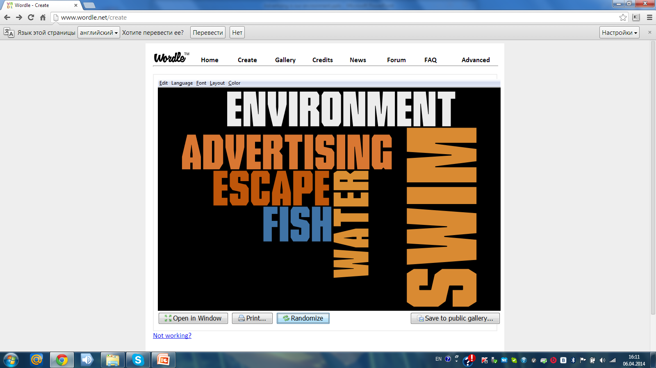
Quotation
our
cannot
is
it
We
in
it

Slide 2
«Advertising is our environment. We swim in it as fish swim in water. We cannot escape it.» JEAN KILBOURNE
“Ads-for and against” 10a form 22/04/14
Chupina L.A.-teacher of English Saint-Petersburg

Slide 3
Listening Ex.2 p.64 SB
Names of speakers | Positive opinion (write some ideas) | Negative Opinion (write some ideas) | Your ideas: agree or disagree
Phil
Liz
Both

Slide 4
Read & Retell the text
  Problem
Reasons
Facts & Arguments
Summary

Slide 5

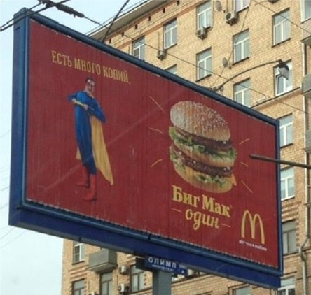
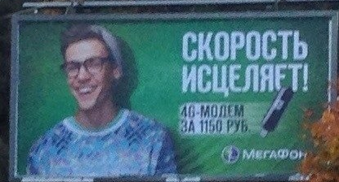

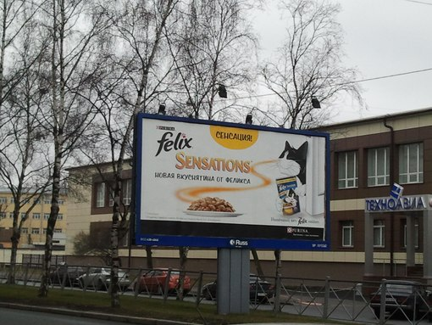
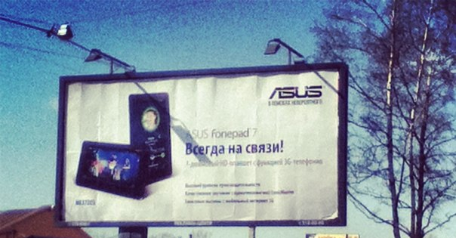
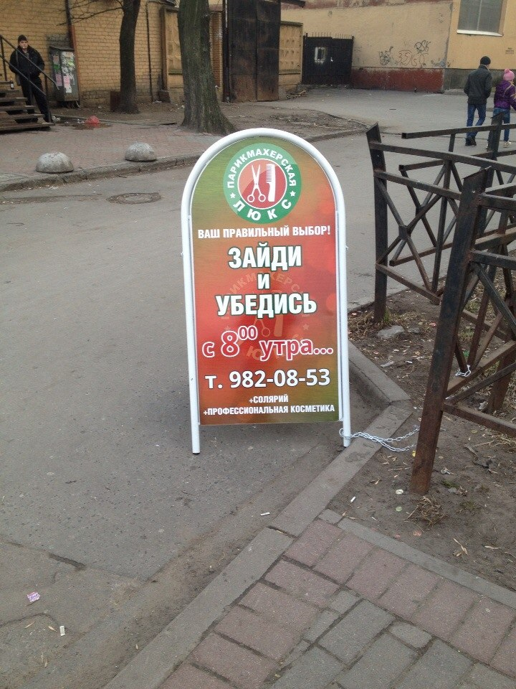

Slide 6
Think of the advert you’ve seen recently.
Tell another student about it using these questions:
Where was the advertisement?
What product was advertised?
What was the picture/the story in it?
Did you like it? Why?/Why not?

Slide 7
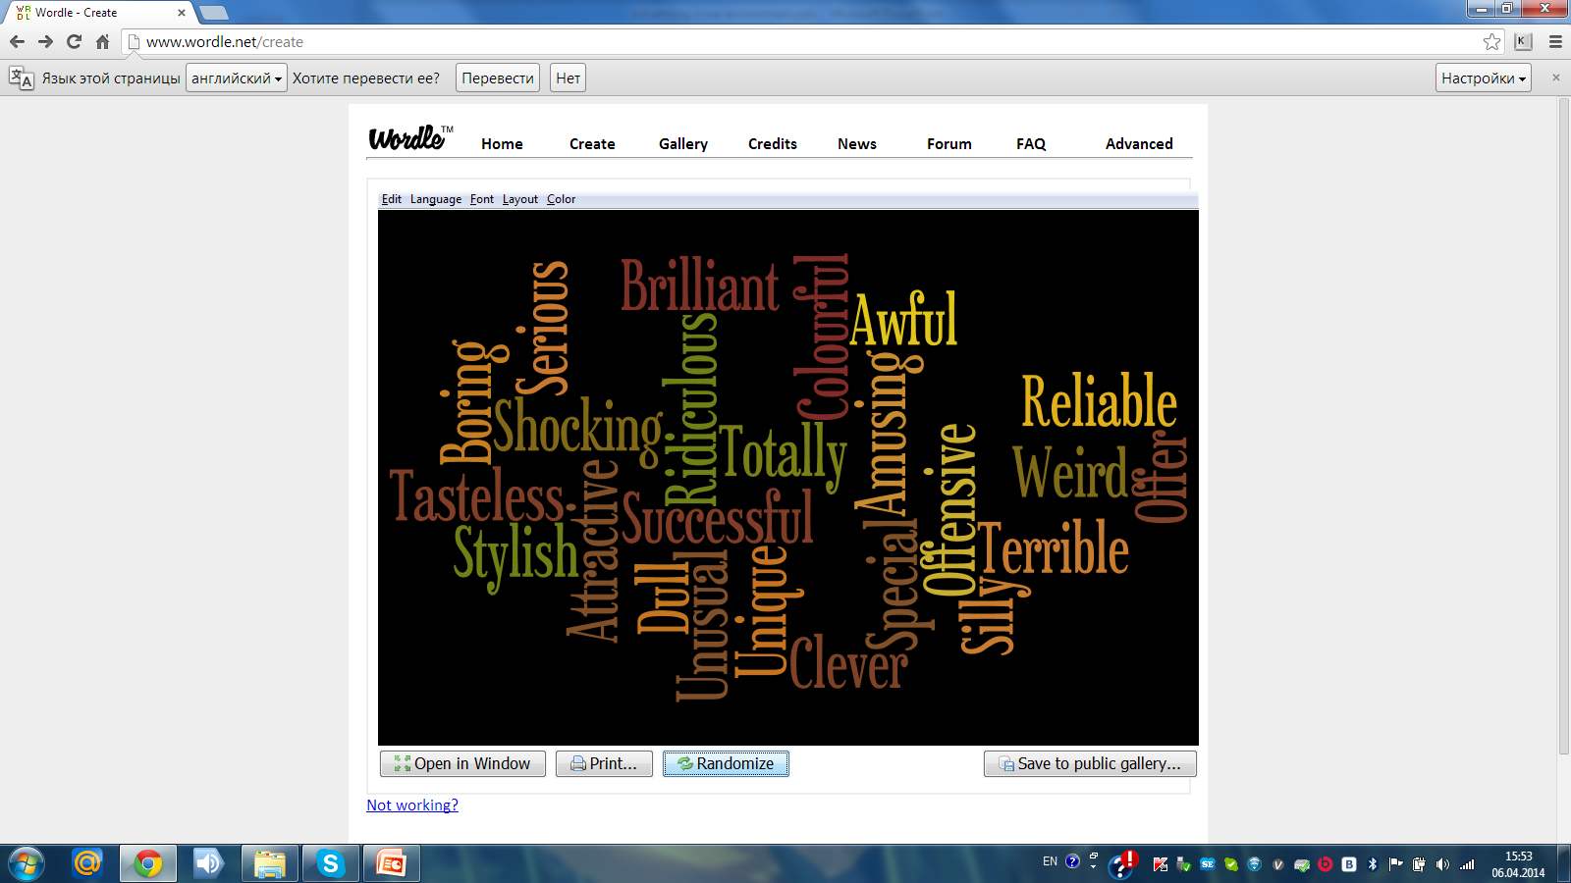
Advertising Expressions and Adjectives

Slide 8
Giving Opinions
Personally, I think…
As for me I think it’s really imaginative
In my opinion this advert makes you think…..
I’m (totally) against…
I don’t believe it….
It gives practical information

Slide 9
Your Own Cinquain
Follow the structure:
1-st line – “The Topic” - one noun
2-nd line – Two adjectives
3-d line – Three verbs referring to “The Topic”
4-th – a sentence or phrase expressing your attitude
5-th – your summary, one word

Slide 10
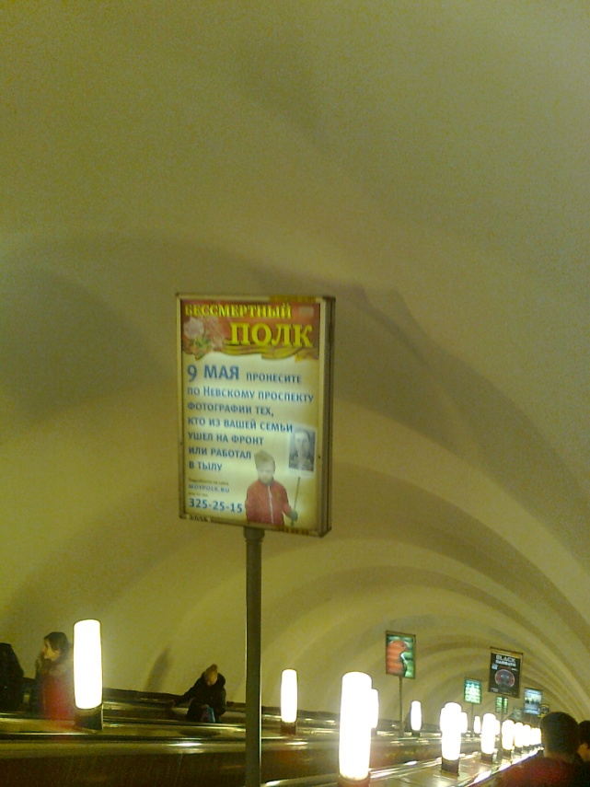
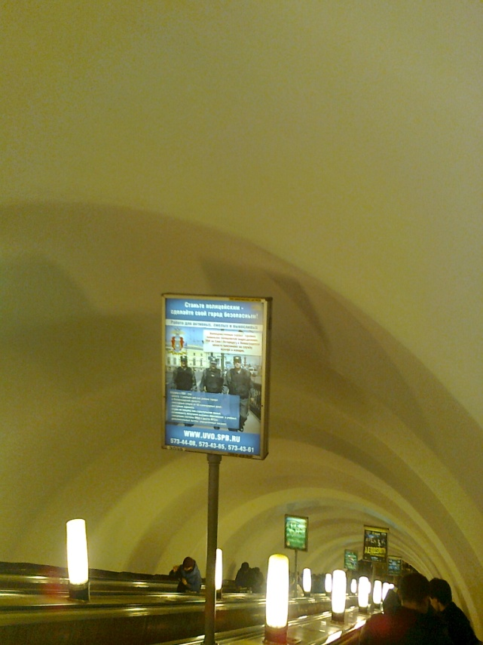
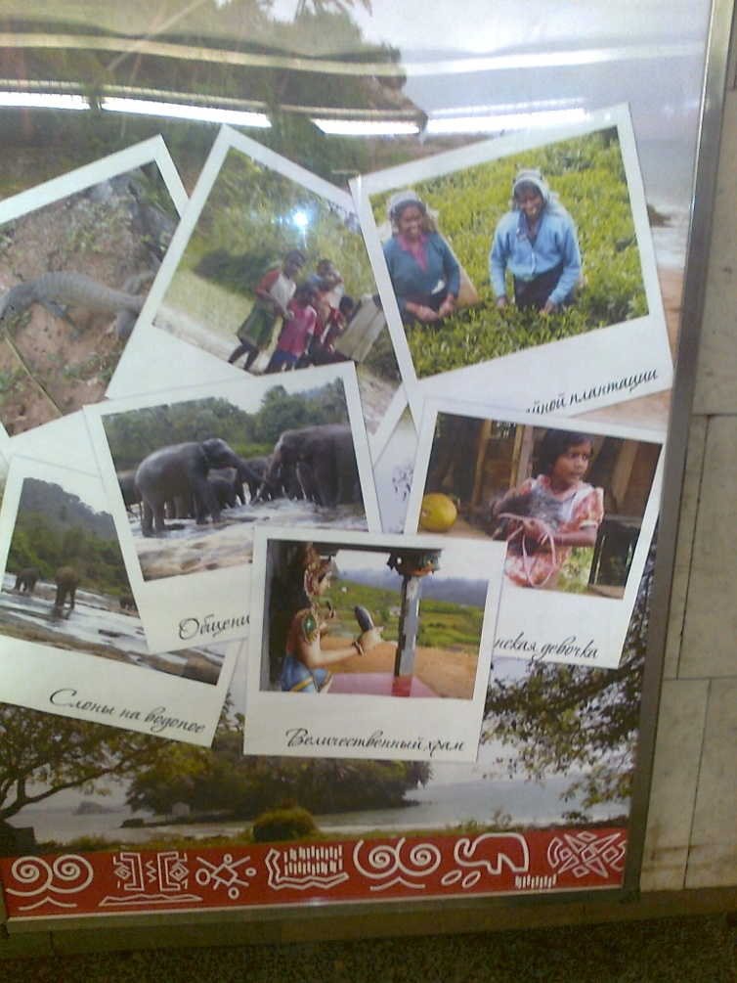
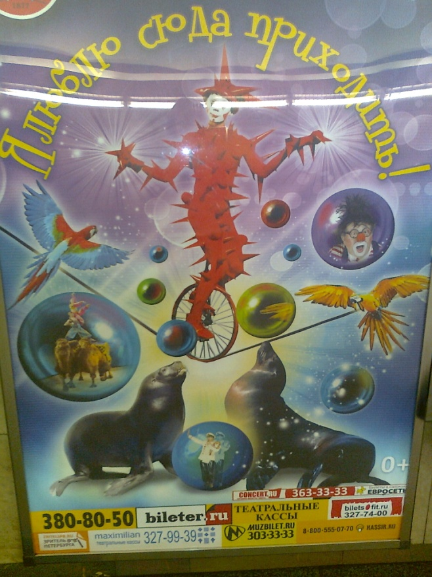
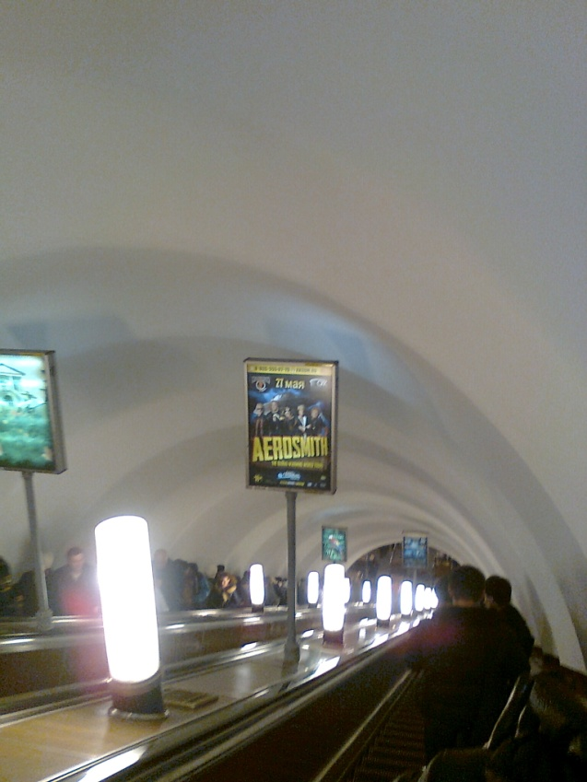


Slide 11
Your hometask
To make an advertisement about our lyceum for its site using word-clouds and the programme wordle.com
Self-assessment of your work at the lesson

Slide 12


